Slide 1
UM-Plan:
Strategic Financial Planning & Analysis Tool
UM-Plan:
Strategic Financial Planning & Analysis Tool
  Logging In
  Last update: November 2023

Slide 2
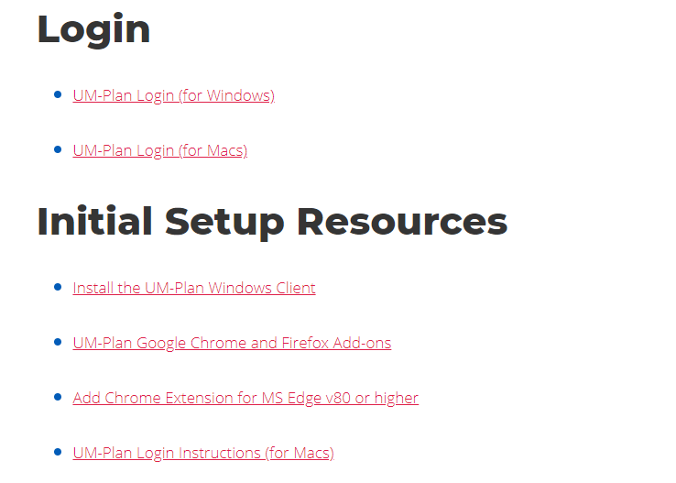
Guiding Principles
All users must install the UM-Plan windows client in order to use the software. You can do this in the Initial Set up Resources section at this link: https://www.umassp.edu/um-plan or you can install the windows client upon your first log-in.

Slide 3
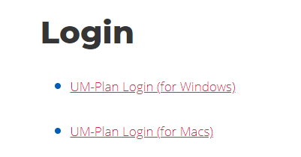
Navigation
Open the UM-Plan web page by accessing the University's “Innovation and Operational Services” page with the following link: https://www.umassp.edu/um-plan
Under the “Login” section select “UM-Plan Login” (For Mac users see “UM-Plan on AWS AppStream Quick Reference Guide)

Slide 4
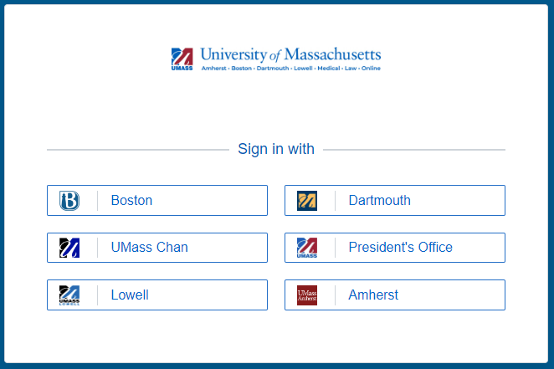
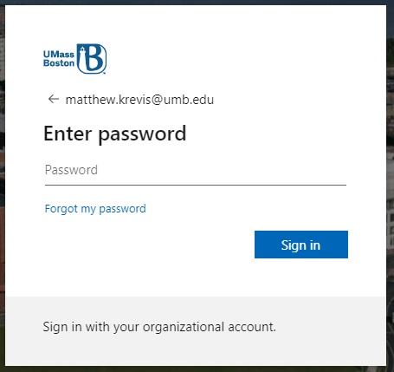
Secure Access Login (Windows)
Select Boston campus
Enter Email and Password

Slide 5
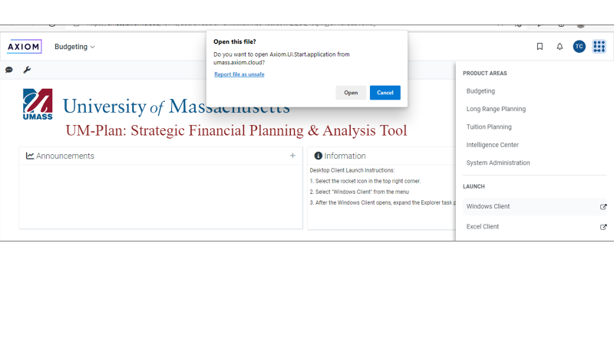
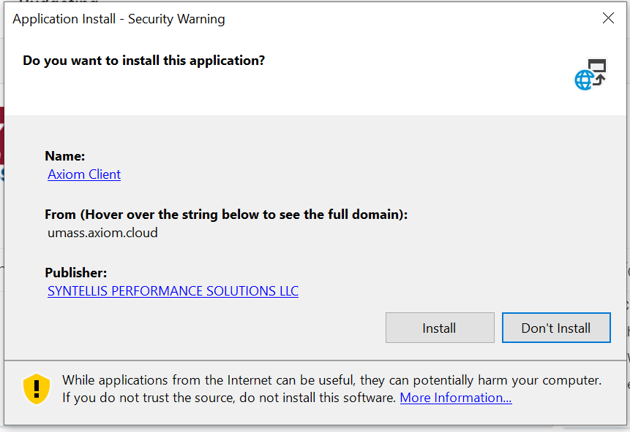
Launch UM-Plan First Time Log-in
Once signed in, select the square in the upper right corner.
Select “Windows Client” from the submenu and “Open” from the pop up box.
You will get a prompt to install the required software, select open and install (details on next slide)

Slide 6
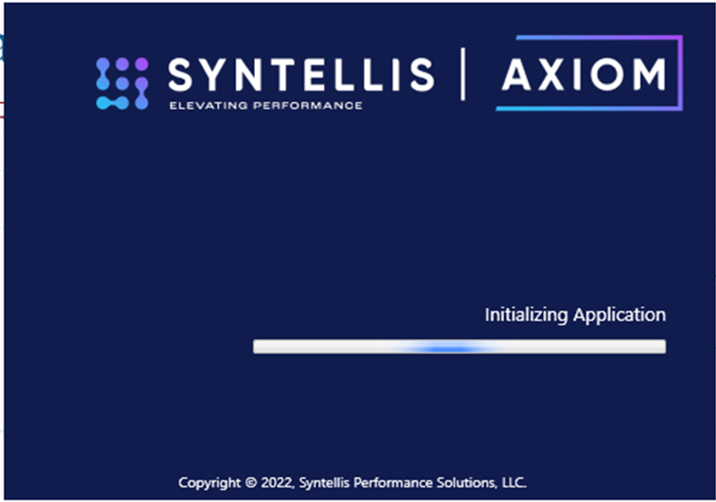
Launch UM-Plan Log-in after install
Once signed in, select the square in the upper right corner.
Select “Windows Client” from the submenu and “Open” from the pop up box.

Slide 7
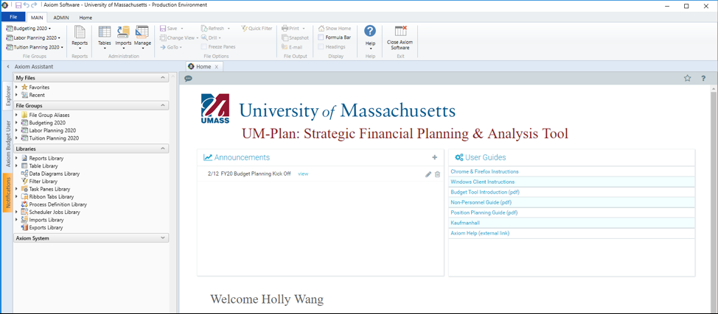
UM-Plan Launched
Once launched, you have successfully logged in to UM-Plan.

