Slide 1
UM-Plan:
Strategic Financial Planning & Analysis Tool
  Position Budget Planning
  Last update: September 2023

Slide 2
Guiding Principles
Position management incumbent employee information in PeopleSoft is the source of position data in UM-Plan.
Position data has been fed to UM-Plan on a snapshot date September 11, 2023.
All positions should be reviewed by your department to ensure complete and accurate information.
Some fields will be managed by the budget office to ensure consistency (for example, fringe rate, merit, and step increases).
  NOTE: Merit in FY25 process contains a placeholder for vacancy savings assumptions.
New position requests or the re-organization of current positions (see: “Guidance on New Positions and Reorganization” training) will be reviewed with your budget area; impact on the number of FTEs and budgeted funds must be considered.
Once approved, updates to position data in PeopleSoft will be made by the Budget and HR offices to reflect approved changes.

Slide 3
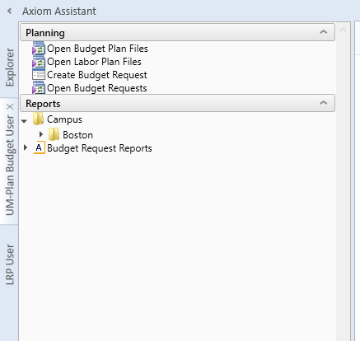
Navigation
Using the “UM-Plan Budget User” selection in Navigation Bar on the left, double click on Open Labor Plan Files

Slide 4
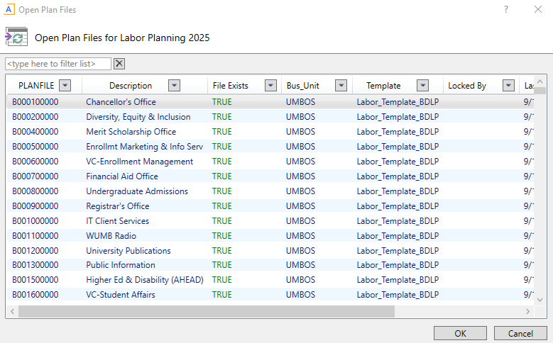
Navigation Cont’d
Double click on the Open Plan File.
Your department’s Labor plan file will open.

Slide 5
Tabs in Plan File
Once a plan file is open you will see that each plan file has a listing of tabs at the bottom that you can navigate
  Positions: Edit and confirm existing positions
  New Positions: Add new positions (see: “Guidance on New Positions and Reorganization” training)
  Funding: High level summary of each position detailing funding sources
  Roster: High level summary of each position inclusive of all funds
  Other Labor: Planning for non-benefitted labor
  Labor Summary: Total labor summary inclusive of all funds
  Labor Summary By Fund: Total labor summary detailing funding sources
  Bold indicates tabs where users will edit/update information

Slide 6
Roster Tab
HR Roster tab is a complete listing of positions with employees, vacant positions, and new positions.
The HR roster tab is a good place to start to help guide you in what benefitted positions may need to be updated on the Positions tab, it is also a good place to review changes you have made in the Positions tab to make sure data is accurate.
Be sure to confirm that all positions listed are still active and should be planned or and that positions that are active have a projected salary.

Slide 7
Labor Plan file: Pre-populated (filled position)
Positions Tab:
Review each position block and confirm that employee information is correct for that position, including:
Start Date
FTE
Working Hours
Pay Type (Salary or Hourly)
Base Salary
Salary Plan Information
Distribution information

Slide 8
Labor Plan file
Step increases and Merit Adjustments are budgeted Centrally and will be disbursed when approved.
  Step Increases in FY25 represent a vacancy savings factor to estimate vacancy savings by individual department
Extra day calculation is done automatically within UM-Plan.
Fringe rates are automatically calculated in UM-Plan using the State’s approved fringe rates.
Only items in blue can be modified.

Slide 9
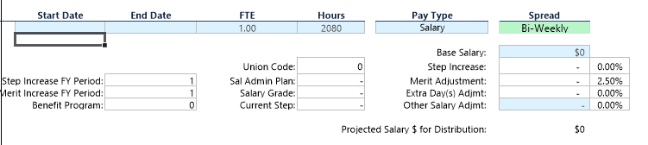
Fields: Requiring Input
Fields shaded light blue editable in UM-Plan
Review the Projected Salary field to ensure the figure appears as expected, the “Other Salary $ Adjmt” field is available to make corrections or updates
Vacant positions have two additional fields that can be edited, “Start Date” and “Base Salary”
  Start Date should be filled with 7/1/2024 to plan for the full year, vacancy savings are planned centrally
  Base salary is prepopulated with position management data and should not require input, in the case that here is no base salary the field will appear blue and you can input the salary if there was an error in pulling in the position from position management.
Vacant Position Example:

Slide 10
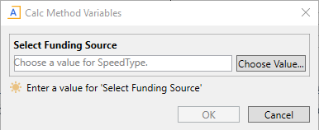
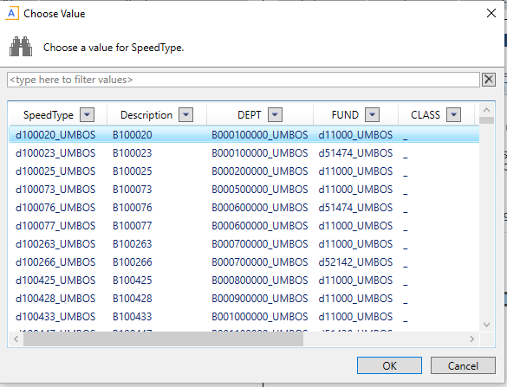
Adding or changing a distribution line
All positions in UM-Plan must have 100% of the salary distributed to a speedtype in order to save the plan file without error
Some positions may not have a distribution line and other positions may need their distribution corrected using the “Insert Distribution Line” selection
  To correct an incorrect distribution please change the “Distribution Override” field to 0% on the incorrect speedtype before using “Insert Distribution Line”
After selecting “Insert Distribution Line” a prompt called “Calc Method Variables” will pop up, select the “Choose Value” box which will allow you to search for the speedtype. Once a speedtype is selected a new distribution line will appear, be sure to fill in the “Distribution Override” field with the appropriate FTE % (all positions must have distribution totaling 100%).

Slide 11
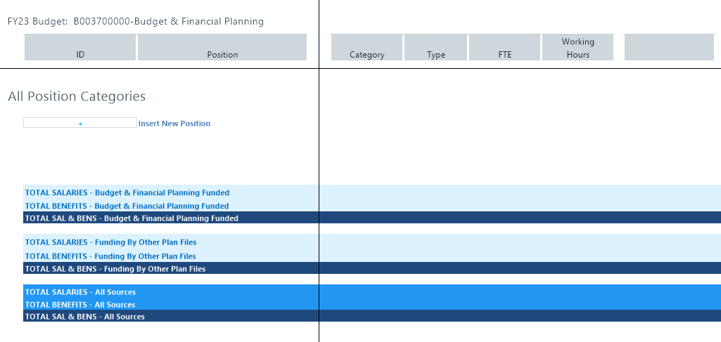
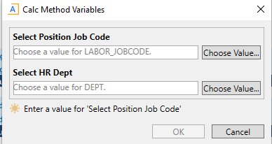
New Positions Tab
To add a position, double click on the plus sign titled “Insert New Position”. Please refer to the “Guidance on New Positions and Reorganization” presentation when determining use of this tab.
Select the most appropriate Job Code and HR Dept by selecting “Choose Value”

Slide 12
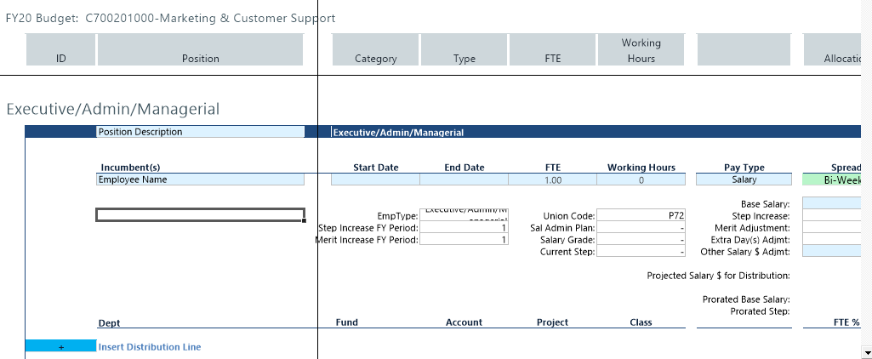
New Positions Tab (con’t)
Complete the form: Incumbent (if known), start date, working hours (typically 2080) and base salary.
Next, double click “Insert Distribution Line” (see adding or changing a distribution line)
Be sure to save your work before logging out.

Slide 13
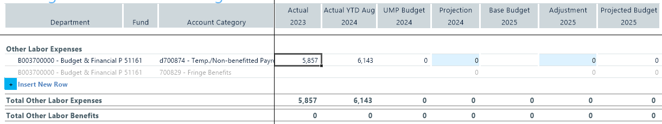
Other Labor
Other Labor is for bulk planning all non-benefitted payroll
Budget is planned at each account subsidiary in the non-benefitted category (Temp./Non-benefitted Payroll, Non-Regular Payroll, Graduate Student Payroll), by department and fund. The blue cells are where you plan the full amount for both Current Year Projection and Budget Year Projection. Fringe amounts populate automatically when planning. In FY25 planning general funds are prepopulated with a target amount and other funds are prepopulated with FY23’s actual values. Areas can change these amounts in these cells other than in funds OBFP have specified to keep at FY23’s actual values (see “High Level Guidance for FY25” presentation).

