Slide 1
UM-Plan:
Strategic Financial Planning & Analysis Tool
  Roll-Up Reports
  Last update: September 2023

Slide 2
Guiding Principles
Budget areas may have multiple labor and budget Plan Files that require a report to view in the aggregate
UM-Plan has reporting functionality to assist areas in rolling up totals from the Plan Files in order to analyze a total submission by college/VC/directorate
Budget Planning file roll-ups can guide areas on their total dollars requested from multiple plan files
Labor planning file roll-ups provide a list of all positions from multiple plan files

Slide 3
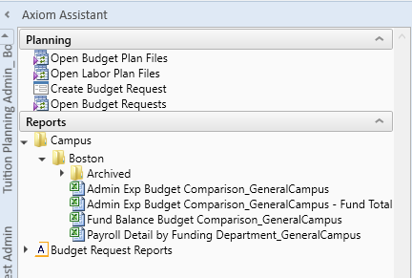
Navigation
Reports can be accessed in the UM-Plan Assistant navigation bar on the left.
In the UM-Plan Budget User Ribbon under reports select Campus > Boston
There are four reports currently. The first three (Admin Budget, Admin Budget – Fund Total, & Fund Balance Budget Comparison) are for roll ups of the Budget Plan Files. The fourth (Payroll Detail by Funding Department) is for a position list contained in the Labor Plan Files, driven by funding source.
Note: Admin Budget - Fund Total condenses all selected funds into one reporting sections

Slide 4
Budget Plan File Reports
The Admin Budget, Admin Budget – Fund Total, & Fund Balance Budget Comparison reports roll up the first two tabs in the Budget Plan Files
  The Admin Exp Budget Comparison report rolls up all data from the “General” tab of the Plan Files
  The Admin Exp Budget Comparison report – Fund Total reports is the same as above, but reports consolidated totals.
  The Fund Balance Budget Comparison report rolls up all data from the “AllOther” tab of the Plan Files

Slide 5
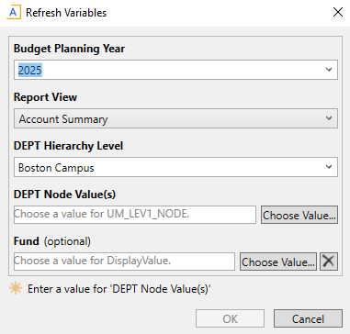
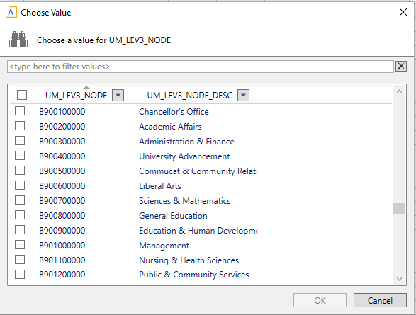
Budget Plan File Reports Cont’d
When Selecting a Budget Plan File (Admin Exp or Fund Balance) report a prompt comes up to assist you in narrowing your selection (shown left)
  Select Budgeting Plan Year (2025)
  Select Report View (Account Summary recommended)
  Department Hierarchy Level dropdown:
    Boston Campus: whole campus view or highest level of individual user access
    Executive/Vice Chancellor
    College/Division
    Budget Area
    Department
  Department node value(s)
    After selecting a Department Hierarchy Level you must click choose value, you will then have a “department tree” level prompt that is used to choose which node you would like to select (College/Division example left)
  Fund
    Choose a fund that you would like to report on, or you can select all funds
  Once you have made your selection click ok and the report will open

Slide 6
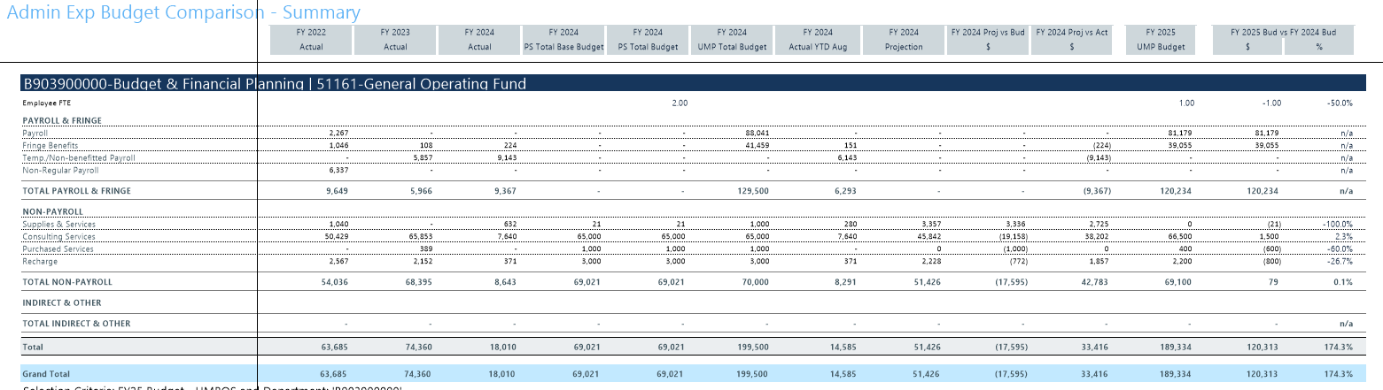
Budget Plan File Reports Example

Slide 7
Labor Plan File Report
The Payroll Detail by Funding Department report rolls up the positions in the Labor Plan File by funding source
    Positions that are not funded by a specific area will not appear in this report
    It is possible to have a position in which a budget area is the home department, but the funding source is a separate budget area, in this circumstance the position will appear in the report from where the position is funded

Slide 8
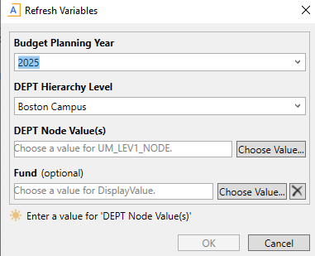
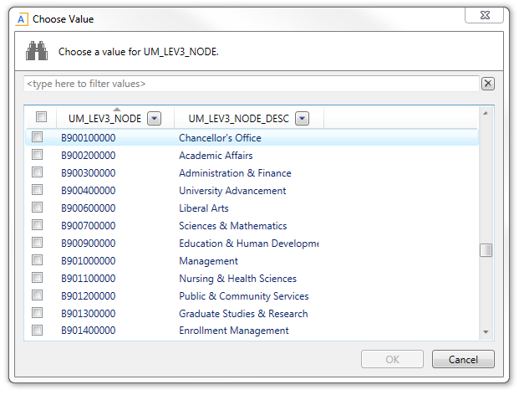
Labor Plan File Report Cont’d
When Selecting a Budget Plan File (Admin Exp or Fund Balance) report a prompt comes up to assist you in narrowing your selection (shown left)
  Select Budgeting Plan Year (2025)
  Department Hierarchy Level dropdown:
    Boston Campus: whole campus view or highest level of individual user access
    Executive/Vice Chancellor
    College/Division
    Budget Area
    Department
  Department node value(s)
    After selecting a Department Hierarchy Level you must click choose value, you will then have a “department tree” level prompt that is used to choose which node you would like to select (College/Division example left)
  Fund
    Choose a fund that you would like to report on, or you can select all funds
  Once you have made your selection click ok and the report will open

Slide 9
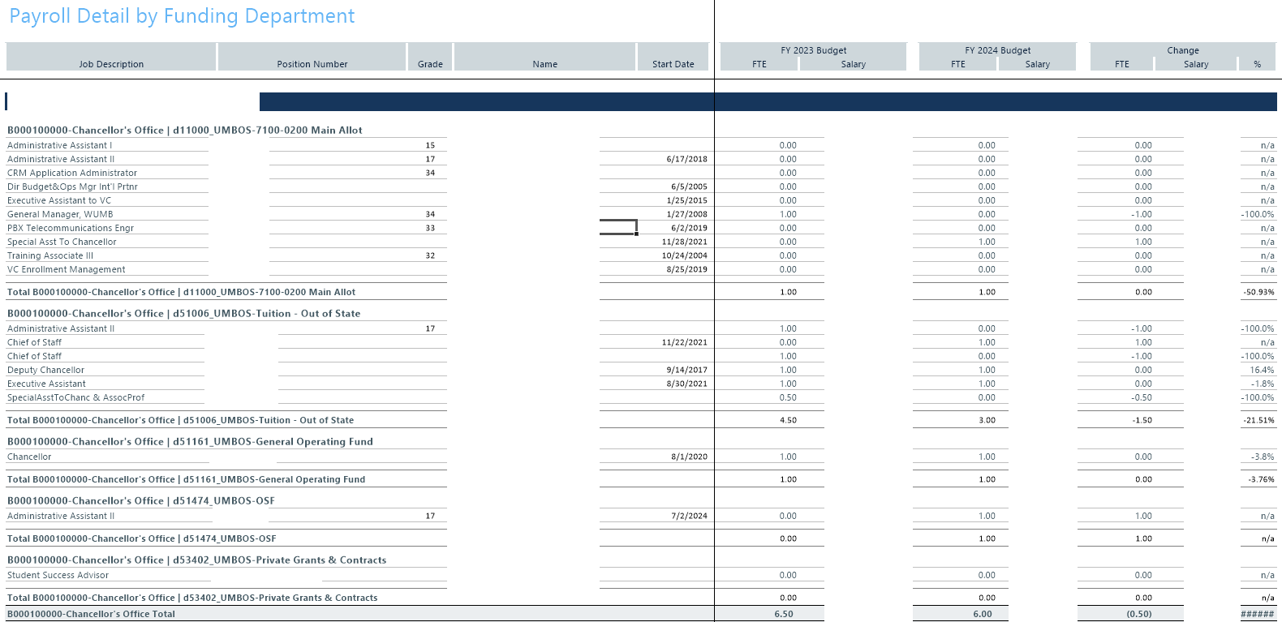
Labor Plan File Report Example (2024 file used)

Slide 10
Exporting to Excel
Please see the “Saving as Local Excel File for Printing and Sharing” presentation to export the reports to an excel local file
  Located at https://www.umb.edu/budget/information

