Slide 1
Controller Update F&A Meeting November 12th, 2024

Slide 2
Contract Management Update: UMASS Contract for Services & Purchase Order Chloe Kondakci Expense Related Contracts

Slide 3
Process: What’s the difference between a Purchase Agreement and Contract for Services?
Contract for Services
Contracts over $100k
Execution Required
Expedited BuyWays Review Process
Changes can be processed via UPST in Buyways contract requests (execution done by UPST/vendor).
Purchase Agreement
Contracts under $100k w/out IT Risk Review
No execution, unless amendment processed UPST case. UPST will coordinate directly with OGC for their review (execution done by the campus - Chloe Kondakci/Chris Giuliani and vendor).
No BuyWays Review Process
UMB Paper
All Redline transferred to amendment
Notes:
Matt Myers’ proposal depository

Slide 4
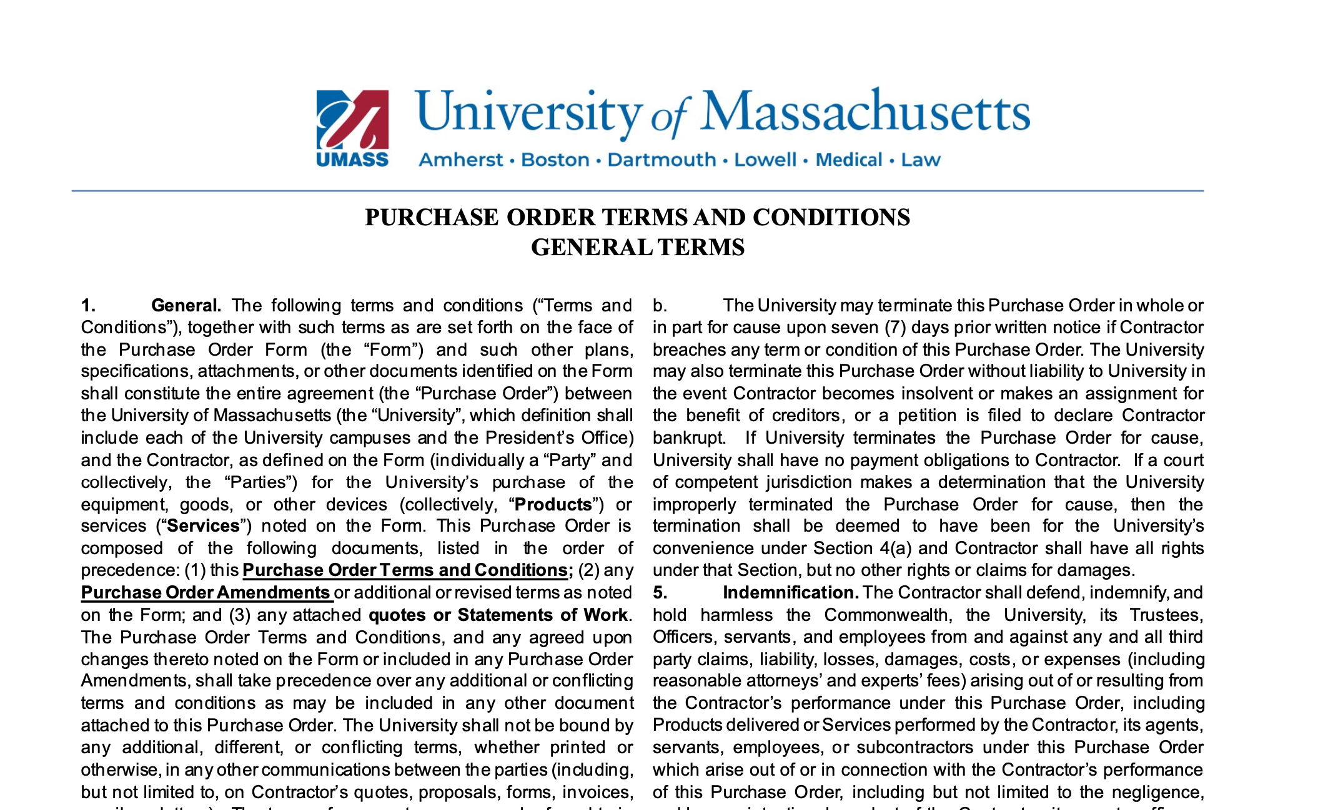
Reference under UPST’s website under forms here.

Slide 5
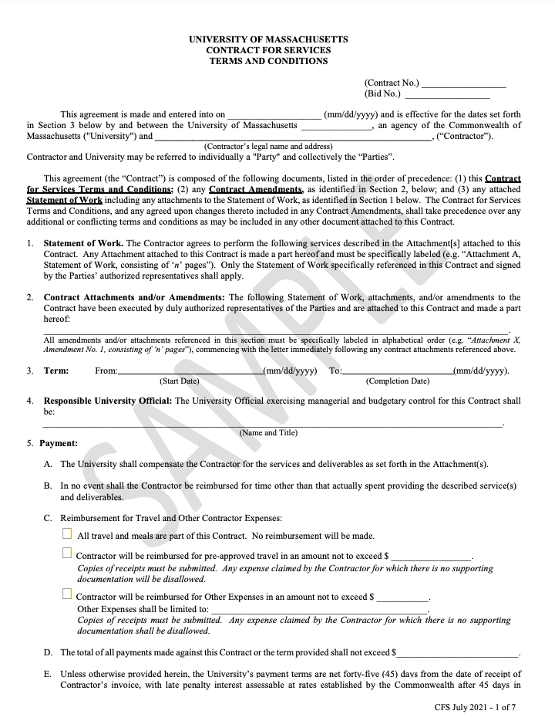
Reference here

Slide 6
Types of Contracts <$100k that cannot be a PO, and need to be on CFS Paper with processed amendments.
﻿﻿Types of Services:
Capital Construction
﻿﻿Financial Information
﻿﻿Software
﻿﻿Software Development
﻿﻿Software as a Service (SaaS)
﻿﻿Services which access to University networks to:
﻿﻿Install technology
﻿﻿Maintain technology
﻿﻿Any service which would:
﻿﻿Create data (IP, PII, PHI, PCI)
﻿﻿Store data (IP, PII, PHI, PCI)
﻿﻿Transmit data (IP, PII, PHI, PCI)
﻿﻿Process data (IP, PII, PHI, PCI)

Slide 7
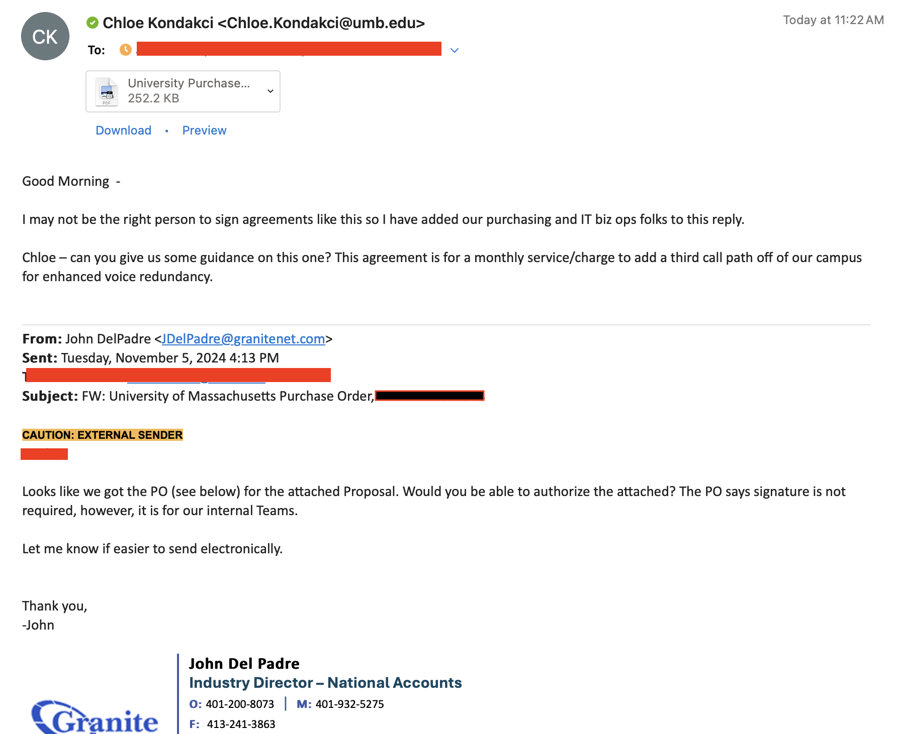

Slide 8
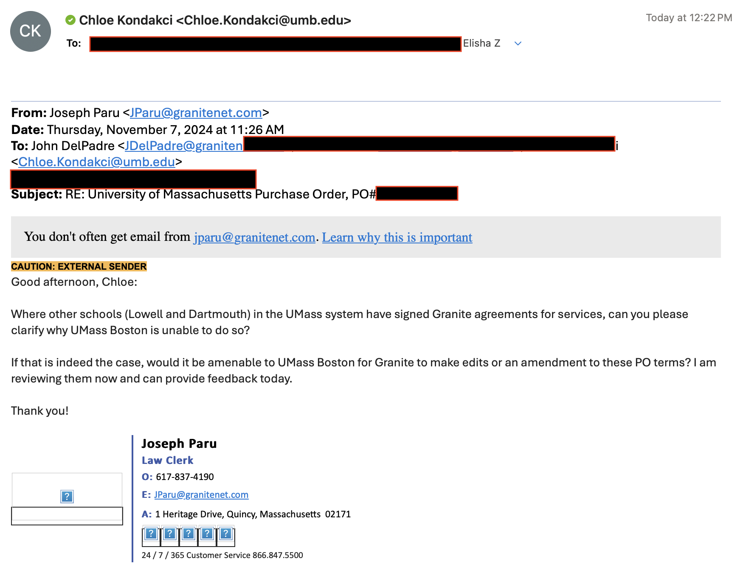

Slide 9
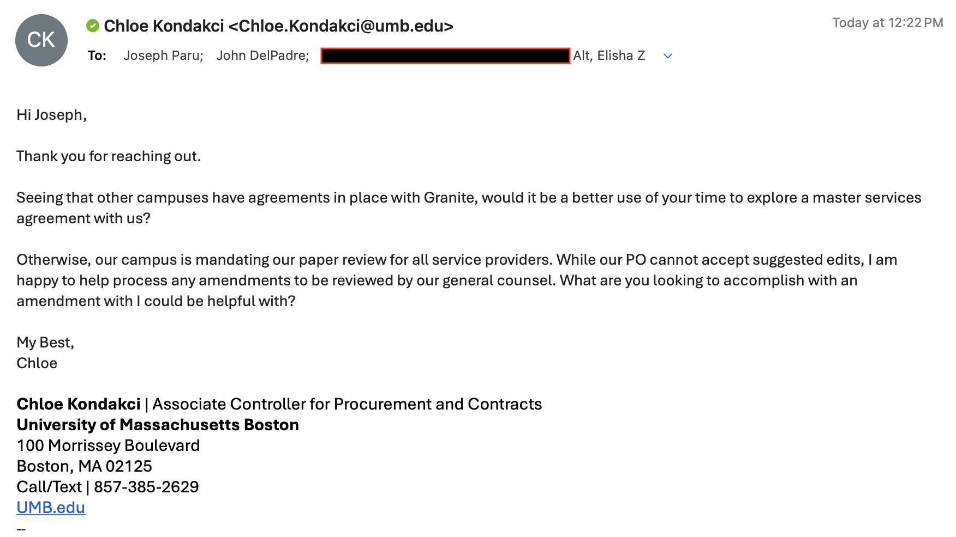

Slide 10
Contract for Services Process
The contract for services template will be populated the vendor’s information when the campus submits a contract request to BuyWays.
**Attach an SOW in Word document, unexecuted in the contract request
Since an SOW template has been attached, our Contract Specialist from UPST will send the populated CFS template to the vendor to review the terms and conditions.
Our job as a campus, is to simply inform the vendor/partner of the process being handled, and to not accept and process the vendor paper. We can accept and review amendments to a PO or CFS.
If there are changes that need to be made to our paper, UPST will process amendments to OGC through a UPST case, and UPST will process amendments to OGC via BuyWays Contract Request.

Slide 11
Scope of Work Process
UMASS SOW (link here)
When a vendor provides their proposal/quotes, please request that they also fill at least the 5 questions on our SOW Template:
Introduction/Purpose
Contractor’s Qualifications to perform the service (license, experience, their unique ability to serve your needs)
Services being provided by the vendor
Deliverables and timeline
Compensation

Slide 13
FAQs:
What happens when a Vendor Requires signature on a PO?
Process a contract for Services
What happens when a vendor states that the review needs to be performed on their paper?
Escalate to Chloe Kondakci, and state that our campus has implemented a new mandate on our paper review, effective 11/12/2024.
What happens when a Vendor Requires redlines on either a PO or Contract for Services?
Redline a PO, create an amendment via UPST Case with the attached redlines. UPST will coordinate with OGC to create an amendment to the PO
Redline the CFS, in BuyWays with the contract specialist from UPST
Will this mandate put my relationship with my supplier at stake?
Typically, utilizing your own paper within an established relationship places you in a position of strategic advantage. Instead of UMB being limited to critiquing the vendor’s terms, this approach anchors your position in a relationship enhancing position, inviting constructive feedback from the other party. We have already seen how this shift in dynamics can foster proactive performance improvements and enhance mutual respect.

Slide 14
Please notify your Vendors of this change now. Email language below:
Upcoming Renewals: Under 100k + never in the past required IT Risk Review, PO
I hope this message finds you well.
I am writing to inform you that UMass Boston has implemented a new mandate requiring all expense-related contracts to be transitioned onto our institutional paper. In line with this, before the next renewal of our agreement, we will need you to review and agree to our purchase order terms and conditions.
Please note that this step is for acknowledgment only and does not require formal execution, and we may review redlines suggestions as needed through our general counsel by drafting an amendment.
If you have any questions or need further clarification, please feel free to reach out, and I would be happy to involve our contract specialist/campus contract controller to the discussion.
Best regards,

Slide 15
Please notify your Vendors of this change now. Email language below:
New Contracts: Under 100k + does not require IT Risk Review, PO
Dear [Vendor Name],
I hope this message finds you well.
I am delighted that we will be working together and am looking forward to our collaboration. As the next step, your team will need to review our purchase order terms and conditions. By agreeing to these terms and accepting the order, this will serve as our formal agreement and does not require further execution. This process will allow us to move forward and begin implementation as soon as possible.
If you have any questions or need further clarification, please feel free to reach out. I’m happy to involve our contract specialist or campus contract controller in the discussion if needed.
Best regards,

Slide 16
Please notify your Vendors of this change now. Email language below:
New Contract: Over 100k, or under 100k + Requires Risk Review, CFS
Dear [Vendor Name],
I hope this message finds you well.
I am delighted that we will be working together and am looking forward to our collaboration. The next step will be for your team to review our contract for services agreement, as mandated from our procurement department. This document will need formal execution to serve as our binding agreement, ensuring we can move forward and begin implementation as soon as possible.
As a next step, please fill out the attached Scope of Work document. After receiving this, I will upload this to our internal procurement system, and our contract specialist will send our contract for services to your team for your review.
If you have any questions or need further clarification, please feel free to reach out. I’m happy to involve our contract specialist or campus contract controller in the discussion if needed.
Best regards,

Slide 17
Please notify your Vendors of this change now. Email language below:
Upcoming Renewals: Over 100k, or under 100k + Requires Risk Review CFS
Dear [Vendor Name],
I hope this message finds you well.
I am writing to inform you that UMass Boston has implemented a new mandate requiring all expense-related contracts to be transitioned onto our institutional paper. In line with this, any contract for services will need to be reviewed and formally executed before the next renewal.
Please be aware that we cannot accept redlines to this agreement, and your signature will be required for execution.
If you have any questions or need further clarification, please feel free to reach. I would be glad to involve our contract specialist or campus contract controller in the discussion as needed.
Best regards,

Slide 18
Departmental Contract Reviews – Expense and Revenue
Annual Departmental Budget Hearings Begin on February 2025
In December and January, we will begin contract reviews from SparcPro dashboards developed from BuyWays data. We will also review revenue driving activities as well.
During this time, we will evaluate the following:
Proactive Contract Management (strategic term developed, services level utilization, anticipate renewal % increase, etc)
Performance tracking (contingencies written down and enforced)
Vendor Contingencies in place (What happens if we need to suddenly switch vendors, lose service, or how can we avoid an unnecessary extension?)
Notes:
Matt Myers’ proposal depository

